Slide 1
chat GPT

Slide 2
Perceptron 1957
Neural Networks
Deep Learning
Artificial Intelligence 1950
Machine learning
DeepMind
2010
ImageNet Challenge 2012
Google
2014
TensorFlow 2015
OpenAI
2015 Elon Musk
AlphaGo 2016
AlphaZero 2017
Twitter
2021
Transformer 2018
Microsoft
2019
Bard
2023
chat GPT
2018~
x.AI
2023

Slide 3
Key Words
Artificial intelligence
Machine Learning
Deep Learning = multiple neural networks
Large Language model (LLM)
Transformer
Training

Slide 4
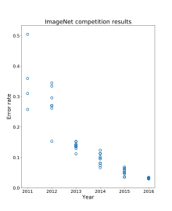
ImageNet - Wikiwand

Slide 5
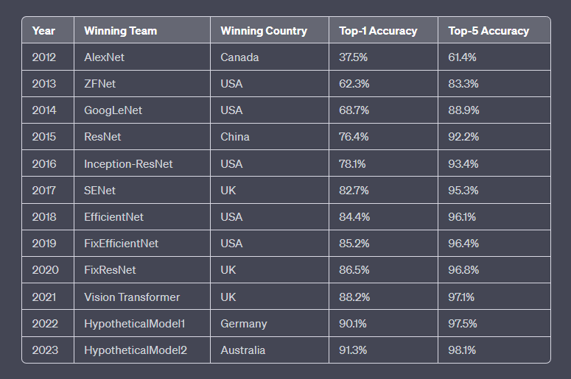
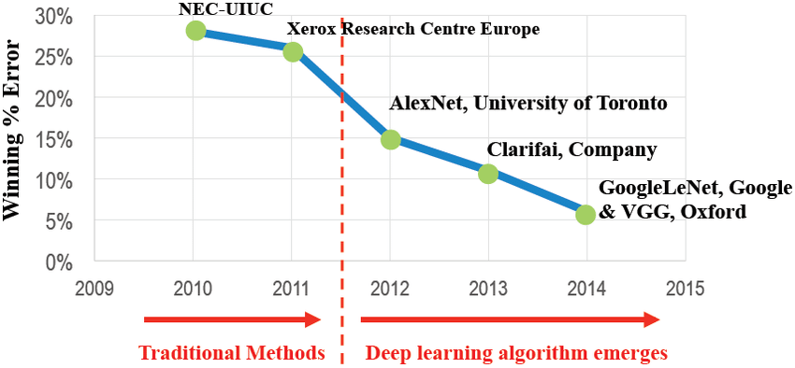
ImageNet Competition Results
https://www.researchgate.net/figure/ImageNet-Competition-Results-50_fig1_329975404

Slide 6

2015
Chat GPT-1 – 2018
Chat GPT-2 – 2019
Chat GPT-3 – 2020
Chat GPT3X – 2022

Slide 7
where:
y is the output of the neural network
() is an activation function
W is the weight matrix
x is the input vector
b is the bias vector
The mathematical formula for a neural network can be expressed as follows:
y = f(Wx + b)
Cost function
Gradient descent
Backpropagation

Slide 8
Feature | AlphaGo 2016 | AlphaZero 2017
Training data | CPU 30 million human Go games Machine learning | GPU (TPU) Self-play Go games Deep Learning
Neural network architecture | Two-network | Single-network
Monte Carlo tree search | MCTS | MCTS with modifications
Peak Elo rating | 3,900 | 4,823
Versatility | Can only play Go | Can play Go, chess, and shogi

Slide 9
Elo rating system
It is a numerical rating system that was originally invented by Arpad Elo, a Hungarian-American physics professor and chess player.
The Elo rating system is based on the idea that a player's rating should reflect their probability of winning against another player. The higher a player's rating, the more likely they are to win against a lower-rated player.
Lee Sedol: 3,778
Ke Jie: 3,766
AlphaGo: 3,900
AlphaZero: 4,823

Slide 10
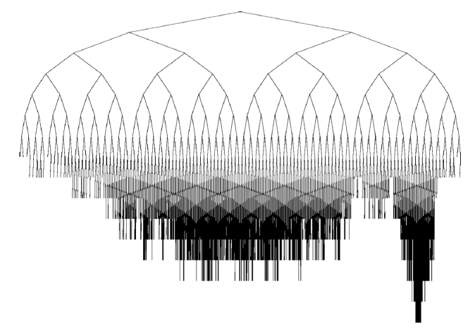
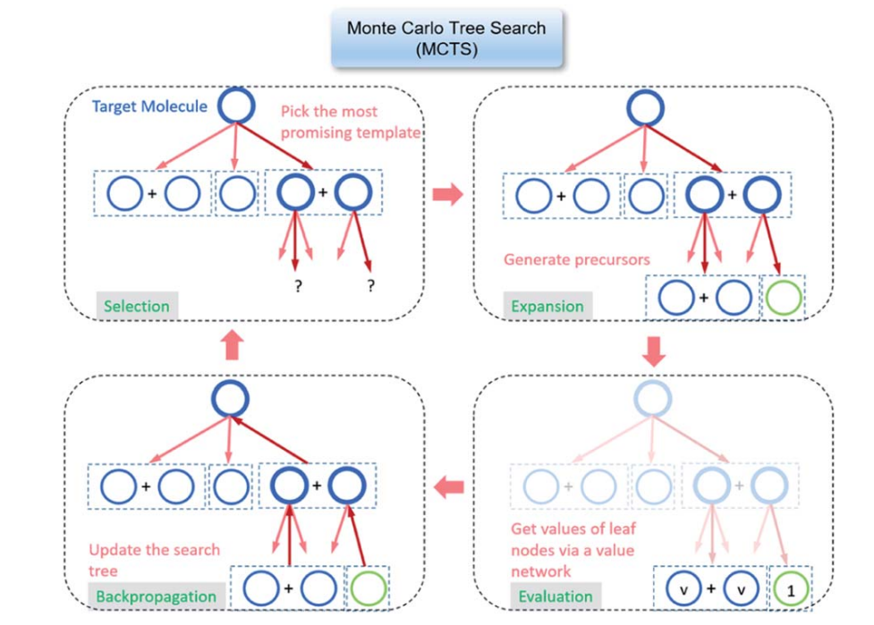
Monte Carlo tree search (MCTS)
a probabilistic algorithm for searching through a game tree.
Go, chess, and shogi.
main steps: selection, expansion, simulation, and backpropagation.
a powerful tool for searching through game trees.

